Slide 1

Basics of Neural Network Programming
Logistic Regression
deeplearning.ai

Slide 2
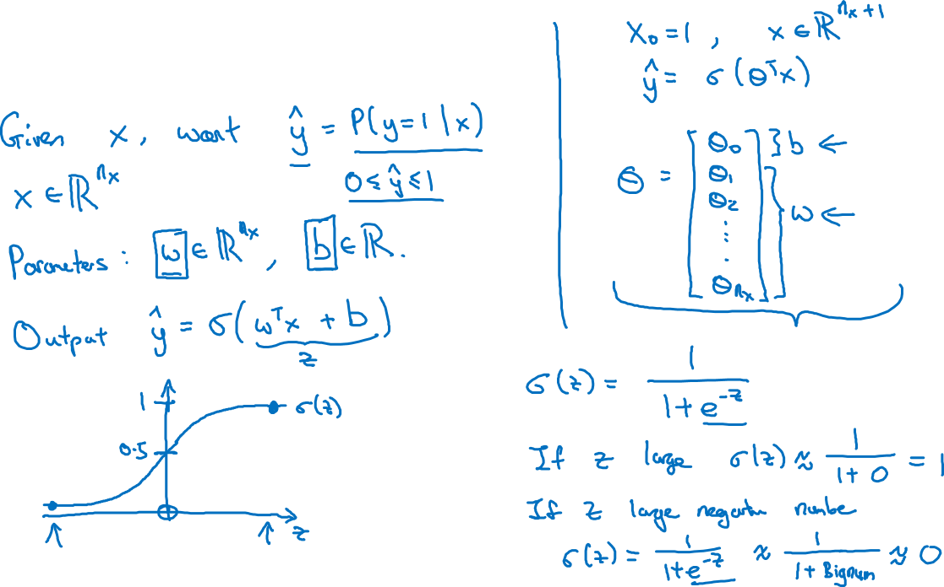
Logistic Regression

Slide 3
Basics of Neural Network Programming
Logistic Regression
cost function
deeplearning.ai

Slide 4
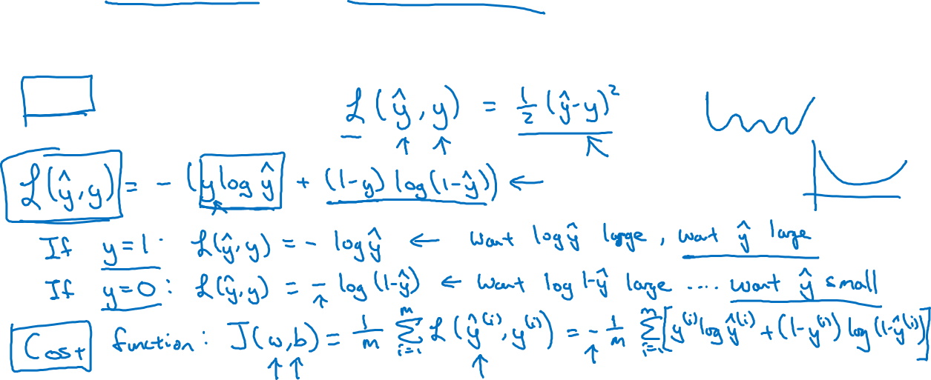
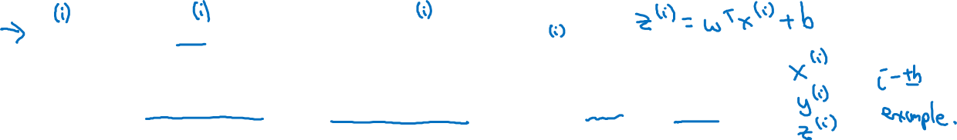
Logistic Regression cost function
$\hat{y} = σ\left(w^{T}x +b\right)$, where $σ\left(z \right)=\frac{1}{1+e^{−z}}$
Given $\left\{{(x}^{(1)},y^{(1)}\text{)}\text{,}\text{…}\text{,}{(x}^{(m)},y^{(m)}\text{)}\right\},$want ${\hat{y}}^{(i)}≈y^{\left(i\right)}$.
Loss (error) function:

